Slide 1
User Acceptance Testing
caMOD 2.0

Slide 2
Purpose
Ensure the overall quality of the program, including but not limited to:
  Absence of anomalies
  Absence of irregularities and inconsistencies
  Valid organization and content
  Performance of the application
Document the results

Slide 3
Schedule
Phase 1
November 9 – November 16, 2005
Phase 2
November 29 – December 6, 2005

Slide 4
URL
http://cancermodels-stage.nci.nih.gov

Slide 5
Structure of the Application
Submission
Search (Animal Models and Drug Screening Results)
Admin Features (Review of Records and Role Management)
User Registration
Help

Slide 6
Collection of Animal Model Data
(the model is the “unit”)
Model Characteristics (name, phenotype)
Genetic Description (transgene, targeted modification, genomic segment, induced mutation, spontaneous mutation)
Carcinogenic Interventions (chemicals, radiation, hormone)
Publications
Histopathology (diagnosis, macroscopic and microscopic description)
Cell Lines (generated from the model)
Therapeutic Approaches (compound, experiment, result)
Images (image description, staining – stored on image server [caIMAGE])
Microarray Data (link to caArray)
Xenograft / Transplant
Model Availability from various sources

Slide 7
Submission
The submitter provides an overview on why and how the model was generated on the Model Characteristics page.
The parts Genetic Description, Carcinogenic Interventions and Xenograft / Transplant offer the opportunity to describe in more detail how the model was generated.
Because there are numerous ways to generate animal models the submission process was build to gather information individually.

Slide 8
Example
double transgenic animal crossed with a knock-out animal, treated with UV-light
Genetic Description part →Enter Engineered Transgene → Transgene 1
Genetic Description part → Enter Engineered Transgene → Transgene 2
Genetic Description → Enter Targeted Modification → Knock-out Gene
Carcinogenic Interventions part → Enter Radiation →
UV-light

Slide 9
Use of controlled vocabularies
To make entries comparable, searchable, and to speed up the submission process
Vocabulary “trees” for anatomy and diseases
Drop-down list on almost every submission page
“Other” option

Slide 10
Testing the Submission of a Record
Duplication of complete record
Deletion of complete record

Slide 11
Submission Detail Pages e.g. Cell line
Check for required fields
Correct error messages
Editing of fields
Deleting of field contents
Deleting of partial records
Tooltips
Context sensitive help

Slide 12
Search
Simple Search
Advanced Search
Table of Contents
Drug Screening Search

Slide 13
Testing the Search Pages
On the simple and advanced search pages – all the items that appear in the drop down lists should return search results.
Table of Contents – verify the correctness of the returned results
Performance

Slide 14
Record Search Detail Pages
Do all data that you entered appear on the search pages?
Empty fields on the search results detail pages
Performance

Slide 15
Drug Screening Search
You can compare the results of your searches with the results on the DTP website:
Yeast Data: http://dtp.nci.nih.gov/dtpstandard/yeast/index.jsp
In vivo data
http://dtp.nci.nih.gov/dtpstandard/InvivoSummary/index.jsp

Slide 16
Admin – Review of Records
Coordinator
- can name screeners and editors
- assigns records and comments to screener and editor
Screener
initial check of record
Editor
scientific reviewer with specific area of expertise

Slide 17
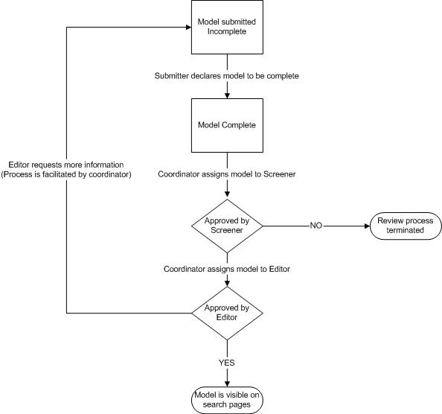

Slide 18
Admin
Privileges for different users – do you see the admin link if you are “just” a public member?

Slide 19
Comments
Can be used to add data to existing records
Can be used for scientific discussions
Will be screened before they go online
Commentator will be identified by name and email address
(user account is required to make comments)

Slide 20
How to record the results of the tests
Test Cases (see Excel spreadsheet)

Slide 21
If you need help
Application Support
caMOD Team

Slide 22
Questions?
Comments?

